Slide 1
Chapter 3
Percents and Their Applications
Math for Business and Finance: an Algebraic Approach, 3rd Edition Jeffrey Slater
© McGraw Hill LLC. All rights reserved. No reproduction or distribution without the prior written consent of McGraw Hill LLC.

Slide 2
Learning Unit Objectives
L U 3-1: Conversions
Convert decimals to percents (including rounding percents), percents to decimals, and fractions to percents.
Convert percents to fractions.
L U 3-2: Application of Percents—Portion Formula.
List and define the key elements of the portion formula.
Solve for one unknown of the portion formula when the other two key elements are given.
Calculate the rate of percent increases and decreases.

Slide 3
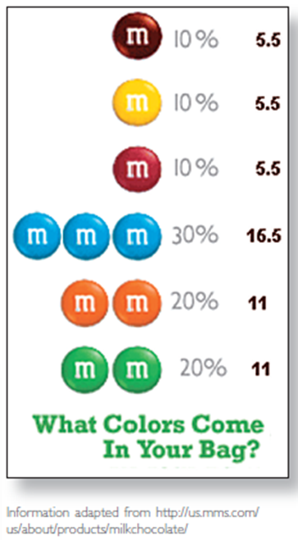
Table 3.1 - Bag of M&M’S
Access the text alternative for slide images

Slide 4
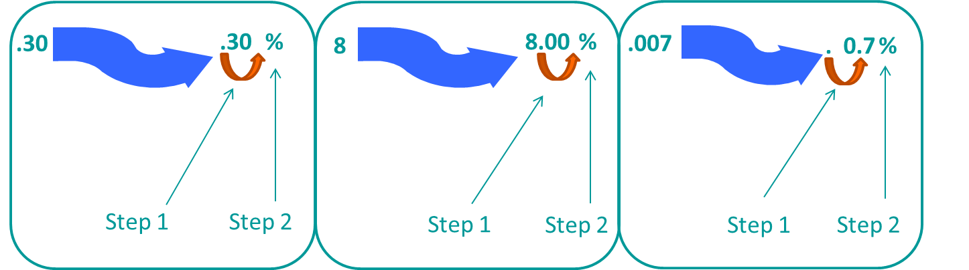
Converting Decimals to Percents
2 Steps
Move decimal point two places to the right. You are multiplying by 100. If necessary, add zeros. This rule is also used for whole numbers and mixed decimals.
Add a percent symbol at the end of the number.
Access the text alternative for slide images

Slide 5
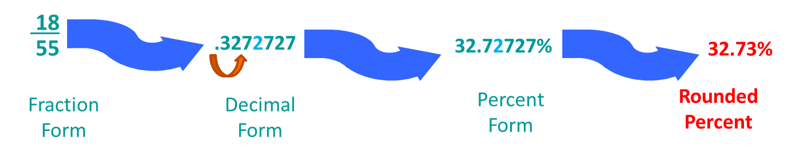
Rounding Percents
3 Steps
When you convert from a fraction or decimal, be sure your answer is in percent form before rounding.
Identify the specific digit. If the digit to the right of the identified digit is 5 or greater, round up the identified digit.
Delete digits to the right of the identified digit.
Example
to the nearest hundredth percent:
Access the text alternative for slide images

Slide 6
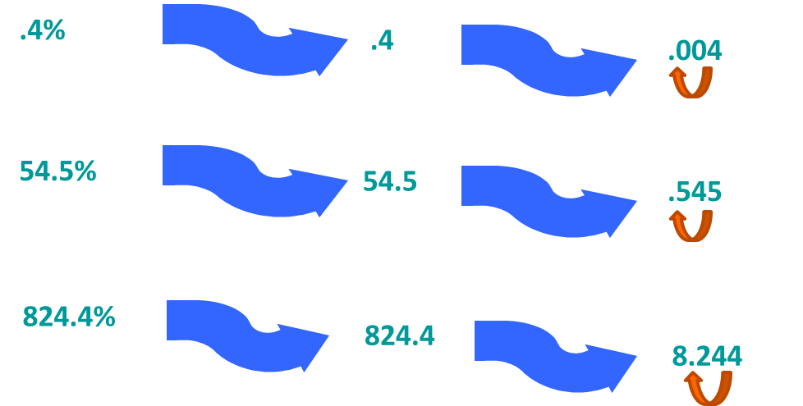
Converting Percents to Decimals
2 Steps
Drop the percent symbol.
Move decimal point two places to the left. You are dividing by 100. If necessary, add zeros.
Access the text alternative for slide images

Slide 7
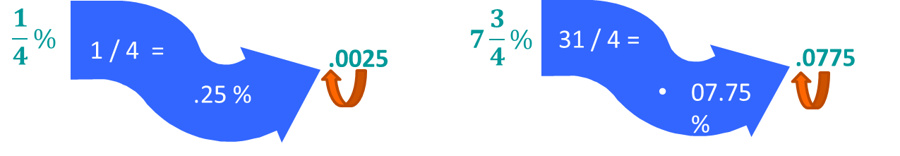
Converting Fractional Percents To Decimals
3 Steps
Convert a single fractional percent to its decimal equivalent by dividing the numerator by the denominator. If necessary, round the answer.
If a fractional percent is combined with a whole number (mixed fractional percent), convert the fractional percent first. Then combine the whole number and the fractional percent.
Drop the percent symbol; move the decimal point two places to the left (this divides the number by 100).
Access the text alternative for slide images

Slide 8
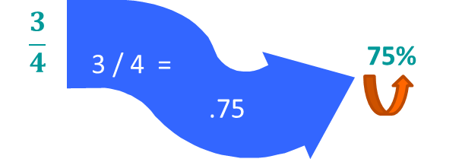
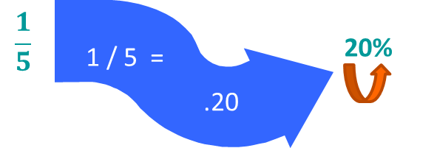
Converting Fractions to Percents
2 Steps
Divide the numerator by the denominator to convert the fraction to a decimal.
Move decimal point two places to the right; add the percent symbol.

Slide 9
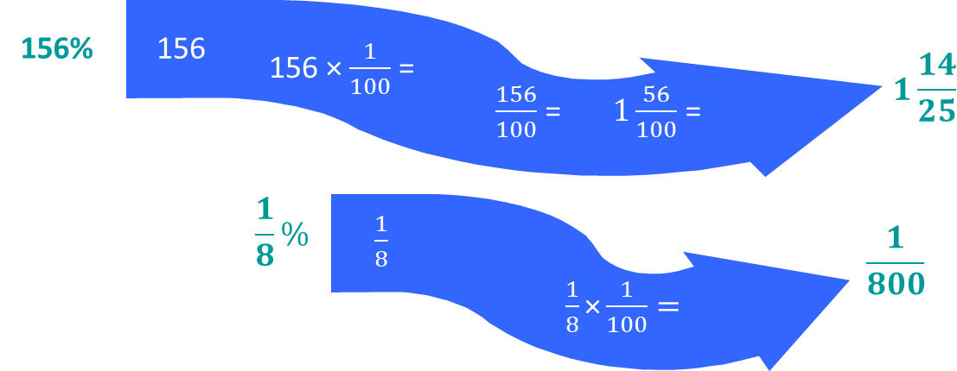
Converting a Whole Percent (or a Fractional Percent) to a Fraction
3 Steps
Drop the percent symbol.
Multiply the number by
Reduce to lowest terms.
Access the text alternative for slide images

Slide 10
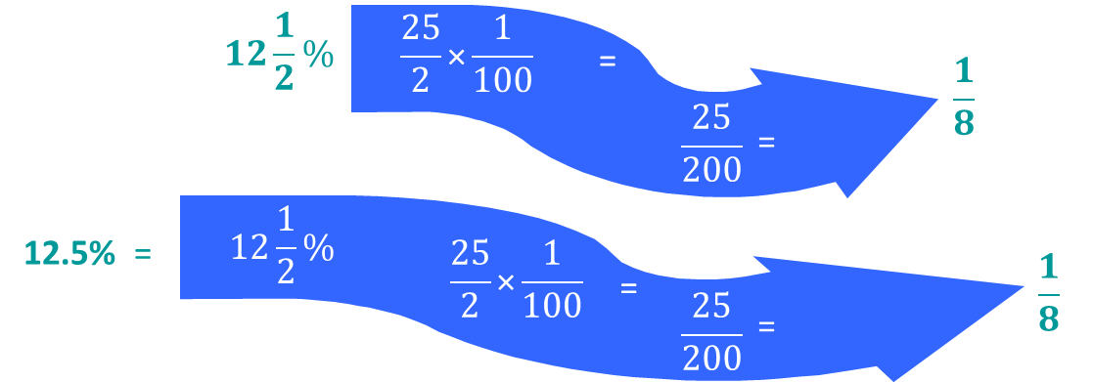
Converting a Mixed or Decimal Percent to a Fraction
4 Steps
Drop the percent symbol.
Change the mixed percent to an improper fraction.
Multiply the number by
Reduce to lowest terms.
Note: If you have a mixed or decimal percent, change the decimal portion to its fractional equivalent and continue with Steps 1 to 4.
Access the text alternative for slide images

Slide 11
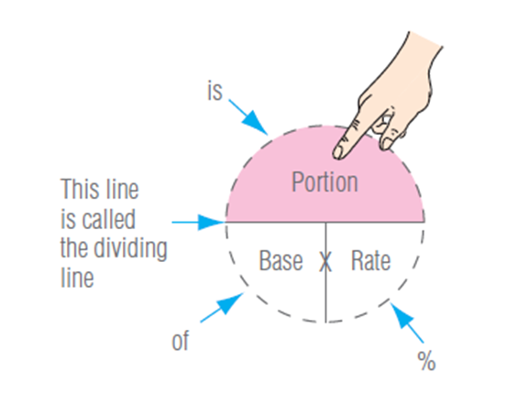
Solving Percents with the Portion Formula
When solving problems involving portion, base, or rate, you must be given two of these elements.
You solve for the third.
Portion (P) = Base (B) × Rate (R)
Access the text alternative for slide images

Slide 12
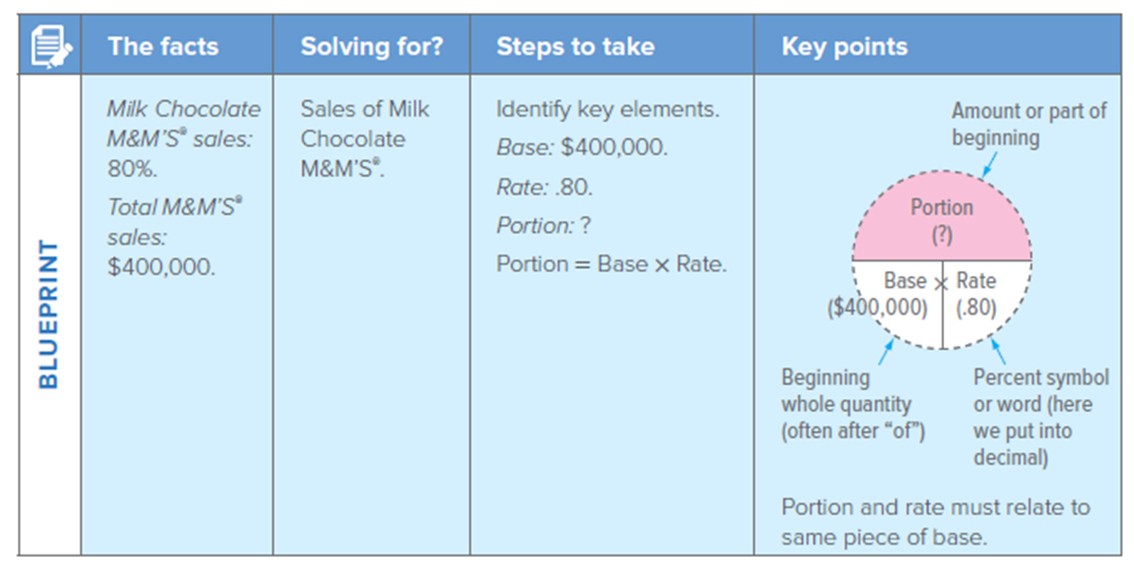
Solving for Portion
Sales of Milk Chocolate M&M’S® are 80% of total M&M’S® sales. Total M&M’S® sales are $400,000. What are the sales of Milk Chocolate M&M’S®?
P = $400,000 × .80 − $320,000
Access the text alternative for slide images

Slide 13
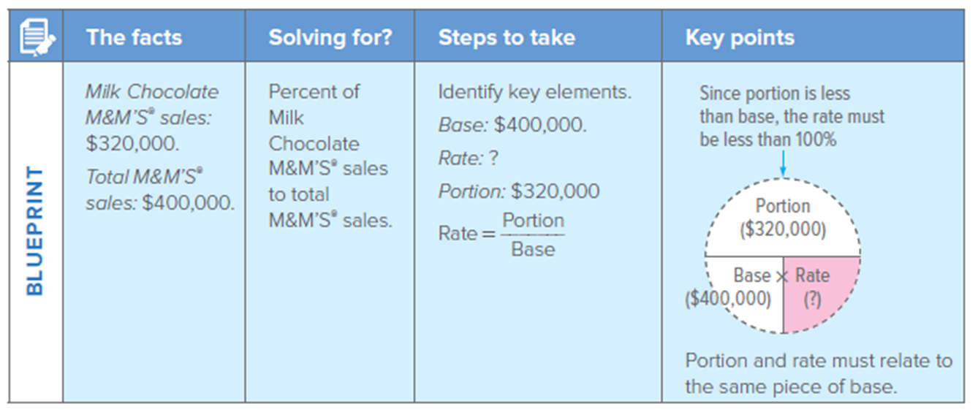
Solving for Rate
Sales of Milk Chocolate M&M’S® are $320,000. Total M&M’S® sales are $400,000. What is the percent of Milk Chocolate M&M’S® sales compared to total M&M’S® sales?
Access the text alternative for slide images

Slide 14
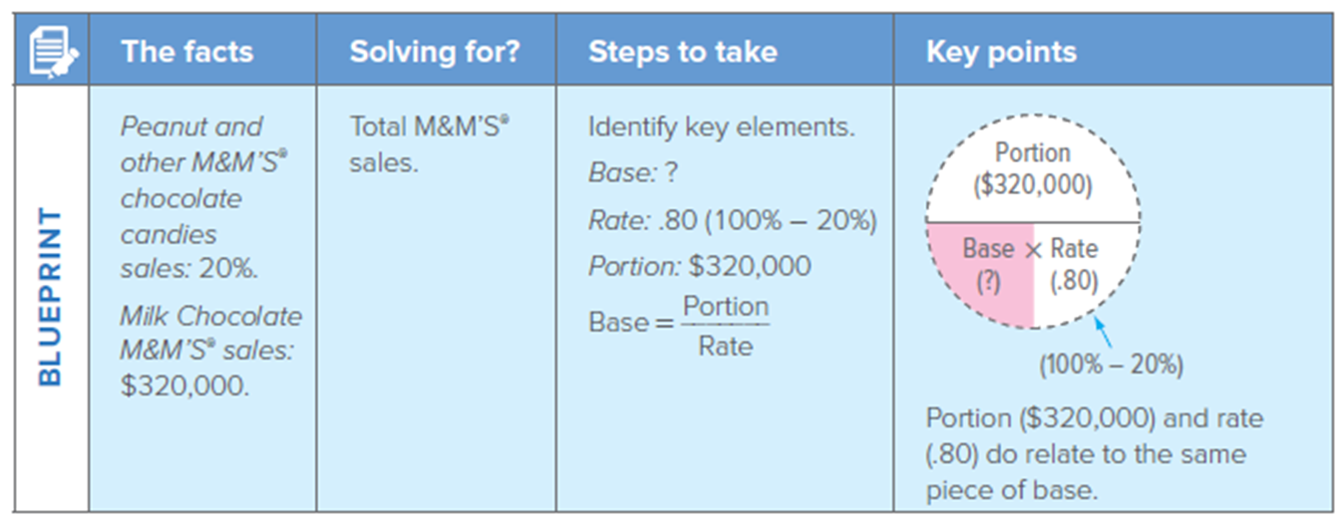
Solving for Base
Sales of Peanut and other M&M’S® chocolate candies are 20% of total M&M’S® sales. The remaining sales are from Milk Chocolate M&M’S®, which are $320,000. What are the total sales of all M&M’S®?
Access the text alternative for slide images

Slide 15
Calculating Percent Increases and Decreases
2 Steps
Find the difference between amounts (such as price per load).
Using the formula R × B = P, solve for R. Be sure to express your answer in percent.

Slide 16
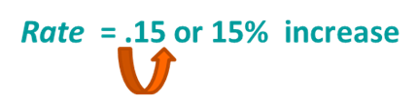
Rate of Percent Increase
Sheila Leary went to her local supermarket and bought a bag of M&M’S®. The bag gave its weight as 18.40 ounces, which was 15% more than a regular 1-pound bag of M&M’S®. Sheila, who is a careful shopper, wanted to check and see if she was actually getting a 15% increase.
Steps to solving problem
Set up the formula.
Rate × Base = Portion
R × B = P
Calculate the rate.
The new weight of the bag of M&M'S® is really 115% of the old weight:

Slide 17
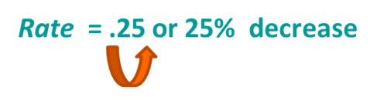
Rate of Percent Decrease
The increase in the price of sugar caused the M&M/Mars company to decrease the weight of each 1-pound bag of M&M’S® to 12 ounces. What is the rate of percent decrease?
Steps to solving problem
Rate × Base = Portion
R × B = P
Set up the formula.
Calculate the rate.
The new weight of the bag of M&M'S® is really 75% of the old weight:

Slide 18
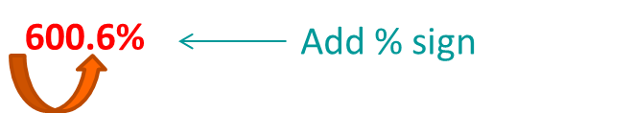
Textbook Problem 3-6
Problem Statement:
Convert the following decimal to percent: L U 3-1(1)
6.006
Solution:

Slide 19
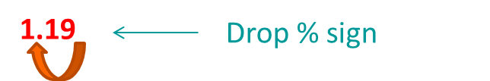
Textbook Problem 3-11
Problem Statement:
Convert the following percent to decimal: L U 3-1(1)
119%
Solution:

Slide 20
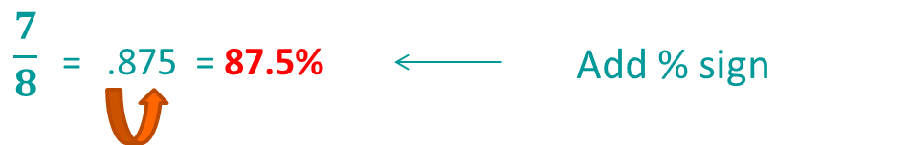
Textbook Problem 3-15
Problem Statement:
Convert the following fraction to percent (round to the nearest tenth percent as needed): L U 3-1(2)
Solution:

Slide 21
Textbook Problem 3-19
Problem Statement:
Convert the following percent to a fraction and reduce to the lowest terms: L U 3-1(2)
Solution:

Slide 22
Textbook Problem 3-26
Problem Statement:
Solve for the portion (round to the nearest hundredth as needed): L U 3-2(2)
119% of 128.9
Solution:

Slide 23
Textbook Problem 3-34
Problem Statement:
Solve for the base (round to the nearest hundredth as needed): L U 3-2(2)
36 is .75% of what number?
Solution:

Slide 24
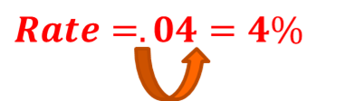
Textbook Problem 3-42
Problem Statement:
Solve for rate (round to the nearest tenth percent as needed): L U 3-2(2)
.09 is what percent of 2.25?
Solution:

Slide 25
End of Main Content
© McGraw Hill LLC. All rights reserved. No reproduction or distribution without the prior written consent of McGraw Hill LLC.

Slide 26
Accessibility Content: Text Alternatives for Images
26

Slide 27
Table 3.1 - Bag of M&M’S – Text Alternative
Return to parent-slide containing images.
The pictograph is shown above the question, What colors come in your bag? Each marble labeled m represents 10 percent. Marbles are shown with their percentage and decimal values, as follows: One red marble, 10 percent, and 5.5. One yellow marble, 10 percent, and 5.5. One brown marble, 10 percent, and 5.5. Three blue marbles, 30 percent, and 16.5. Two orange marbles, 20 percent, and 11. Two green marbles, 20 percent, and 11.
Return to parent-slide containing images.

Slide 28
Converting Decimals to Percents – Text Alternative
Return to parent-slide containing images.
On the left, point 3 0 is the value shown, which is represented as point 3 0. Step 1 involves moving the decimal point two places to the right making the value 30. Step 2 involves adding a percent symbol at the end of 30. At the center, 8 is the value shown, which is represented as 8.00. Step 1 involves moving the decimal point two places to the right making the value 800. Step 2 involves adding a percent symbol at the end of 800. On the right, point 0 0 7 is the value shown. Step 1 involves moving the decimal point two places to the right making the value 0.7. Step 2 involves adding a percent symbol at the end of 0.7.
Return to parent-slide containing images.

Slide 29
Rounding Percents – Text Alternative
Return to parent-slide containing images.
18 over 55 in fraction form is changed to point 3 2 7 2 7 2 7 in decimal form. The decimal point in the decimal form is moved two places to the right and is changed as 32.72727 percent in percent form. The percent form is changed as 32.73 percent in rounded percent.
Return to parent-slide containing images.

Slide 30
Converting Percents to Decimals – Text Alternative
Return to parent-slide containing images.
On the top, point 4 percent is changed as point 4, which in turn is then changed as point 0 0 4 by moving the decimal point two places to the left and adding zeros. In the middle, 54.5 percent is changed as 54.5, which in turn is then changed as point 5 4 5 by moving the decimal point two places to the left. At the bottom, 824.4 percent is changed as 824.4, which in turn is then changed as 8.244 by moving the decimal point two places to the left.
Return to parent-slide containing images.

Slide 31
Converting Fractional Percents To Decimals – Text Alternative
Return to parent-slide containing images.
On the left, 1 by 4 percent is changed as 1 by 4 which equals point 2 5 percent, which in turn is converted as point 0 0 2 5 by removing the percent symbol and shifting the decimal point two places to the left and adding zeros. On the right, 7 times 3 by 4 percent is changed as 31 by 4 which equals 07.75 percent, which in turn is converted as point 0 7 7 5 by removing the percent symbol and shifting the decimal point two places to the left.
Return to parent-slide containing images.

Slide 32
Converting a Whole Percent (or a Fractional Percent) to a Fraction – Text Alternative
Return to parent-slide containing images.
On the top, 156 percent is changed to 156, multiplied by 1 over 100 giving 156 over 100, which equals 1 times 56 over 100, which in turn is reduced to 1 times 14 over 25. At the bottom, 1 by 8 percent is changed as 1 by 8, which is multiplied by 1 over 100 to give 1 over 800 finally.
Return to parent-slide containing images.

Slide 33
Converting a Mixed or Decimal Percent to a Fraction – Text Alternative
Return to parent-slide containing images.
On the top, 12 times 1 by 2 percent is changed as 25 by 2, which is multiplied by 1 over 100 to give 25 over 200 which in turn forms 1 by 8 finally. At the bottom, 12.5 percent equals 12 times 1 by 2 percent, which in turn is changed as 25 over 2, multiplied by 1 over 100 to give 25 over 200 which forms 1 by 8 finally.
Return to parent-slide containing images.

Slide 34
Solving Percents with the Portion Formula – Text Alternative
Return to parent-slide containing images.
A dashed circle is shown. The upper half of the circle is shaded and represents portion. The lower half is divided into two halves with the left half labeled base and the right half labeled rate. Multiplication symbol is between base and rate. The horizontal line dividing the circle into upper and lower halves is called the dividing line. Word Is is pointing toward portion, word of toward base, and percentage symbol toward rate.
Return to parent-slide containing images.

Slide 35
Solving for Portion – Text Alternative
Return to parent-slide containing images.
The facts column reads as follows: Milk Chocolate M and M’s sales: 80 percent. Total M and M’s sales: 400,000 dollars. Solving for? column reads as follows: Sales of milk chocolate M and M’s. Steps to take column reads as follows: Identify key elements. Base: 400,000 dollars. Rate: point 80. Portion: question mark. Portion equals base times rate. Key points column reads as follows: Upper half of a circle represents portion, which has to be found out. Base in the left lower half is indicated as 400,000 dollars. Rate in the right lower half is indicated as point 80. Multiplication symbol is between base and rate. Portion represents amount or part of beginning. Base represents beginning whole quantity (often after of). Rate represents percent symbol or word (here we put into decimal). Portion and rate must relate to same piece of base.
Return to parent-slide containing images.

Slide 36
Solving for Rate – Text Alternative
Return to parent-slide containing images.
The facts column reads as follows: Milk Chocolate M and M’s sales: 320,000 dollars. Total M and M’s sales: 400,000 dollars. Solving for? column reads as follows: Percent of milk chocolate M and M’s sales to total M and M’s sales. Steps to take column reads as follows: Identify key elements. Base: 400,000 dollars. Rate: question mark. Portion: 320,000 dollars. Rate equals portion over base. Key points column reads as follows: Upper half of a circle represents portion indicated as 320,000 dollars. Base in the left lower half is indicated as 400,000 dollars. Rate in the right lower half has to found out. Multiplication symbol is between base and rate. Since portion is less than base, the rate must be less than 100 percent. Portion and rate must relate to same piece of base.
Return to parent-slide containing images.

Slide 37
Solving for Base – Text Alternative
Return to parent-slide containing images.
The facts column reads as follows: Peanut and other M and M’s chocolate candies sales: 20 percent. Milk Chocolate M and M’s sales: 320,000 dollars. Solving for? column reads as follows: Total M and M’s sales. Steps to take column reads as follows: Identify key elements. Base: question mark. Rate: point 80 open parenthesis 100 percent minus 20 percent close parenthesis. Portion: 320,000 dollars. Base equals portion over rate. Key points column reads as follows: Upper half of a circle represents portion indicated as 320,000 dollars. Base in the left lower half has to be found out. Rate in the right lower half is indicated as point 80. Multiplication symbol is between base and rate. Rate is 100 percent minus 20 percent. Portion of 320,000 dollars and rate of point 8 0 do relate to the same piece of base.
Return to parent-slide containing images.

